Slide 1
MiSeq Validation Pipeline
Michael Wornow
8/3/15

Slide 2
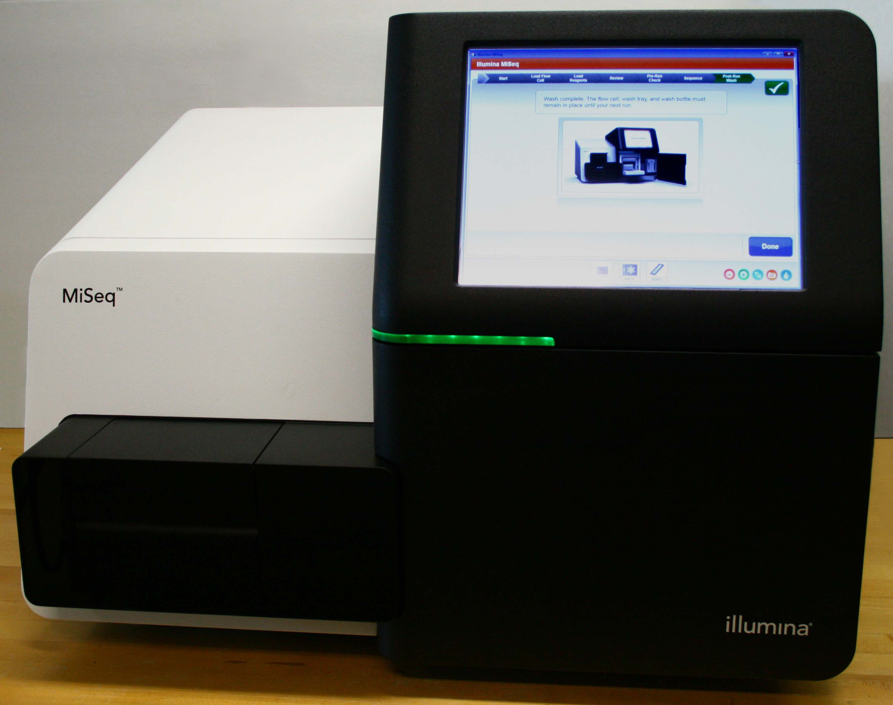
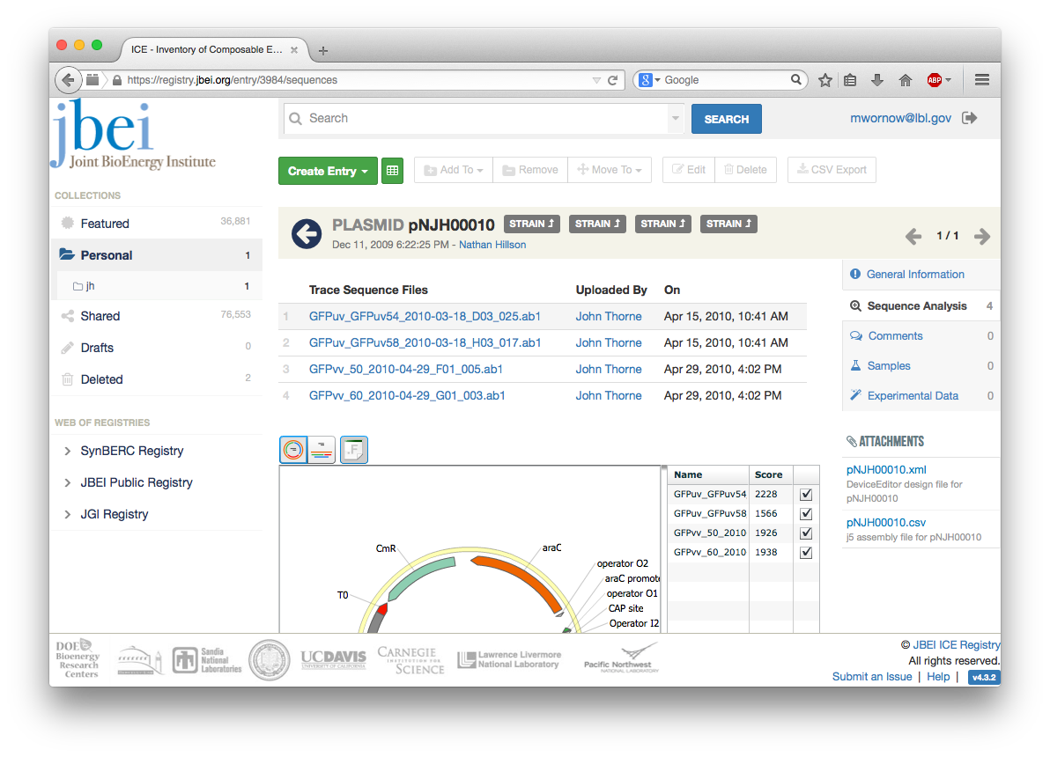
MiSeq FASTQ => ICE Entry
Pipeline.py
Illumina MiSeq
ICE Entry
Run name
Sample IDs
IGV XML
HTML
Excel
Notes:
We want to take sequencing results from the MiSeq and compare them against a reference ICE entry to see if they are valid

Slide 3
MiSeq file terminology
Main Library
SubLibrary1 (aka Pool1 or Sample1)
1-2 fastq.gz
SubLibrary2
1-2 fastq.gz
SubLibrary3
1-2 fastq.gz
1 Reference Sequence
FASTA from ICE entry
Notes:
Each sequencing run is known as the “main Library.” Within each Main Library are multiple “SubLibraries,” “Samples,” or “Pools” (as they’re known on the PacBio). Each SubLibrary can contain 1 or 2 fastq.gz files, depending on if the read was single or paired

Slide 4
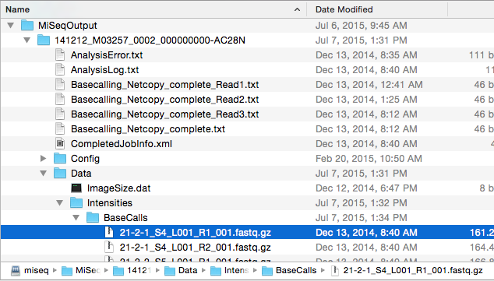
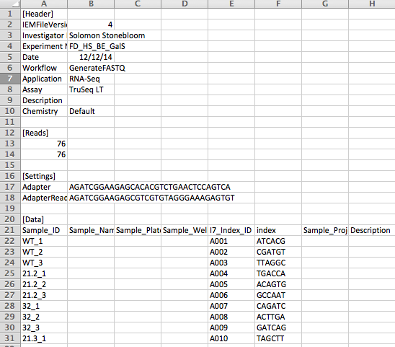
Pipeline Process
FASTQ
BAM
VCF & BED
IGV, HTML, Excel
MiSeq BAM Generation
Perl
NERSC-specific
GATK
Java
Post-Processing
Python
SMB Server
SampleSheet.csv
Notes:
FASTQ files for each sequencing run are pulled from JBEI’s SMB Server. The exact names of the sequencing results are taken from the SampleSheet.csv file, located in the MiSeqOutput folder of the SMB Server.
These FASTQ files are passed to MiSeq BAM Generation Tools Perl scripts, which were modified to not be NERSC-dependent, to generate BAM files.
The GATK generates VCF and BED files, then Postprocessing, to generate IGV file and HTML and Excel summaries

Slide 5
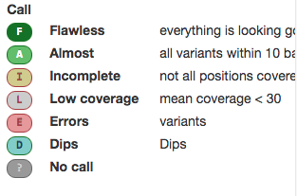
In-depth
MiSeq BAM Generation Tools
Aligns SubLibrary’s reads to a reference sequence
Generates: BAM for every SubLibrary
BAM file: Alignment of a sequence to 1+ reference sequences
GATK
Calculates coverage, depth, and finds SNPs in aligned reads
Generates: VCF, BED, covdepth
VCF: Info on SNPs (mutations that are only one nucleotide)
BED: Annotations of aligned reads
Covdepth: Coverage and depth of aligned reads
Post-Processing
Makes calls on coverage information
Generates: call_summary.txt, IGV, HTML, Excel
Call_summary.txt: Summary of calls for each SubLibrary
IGV: Links to BED, BAM, and VCF files, to view in IGV Viewer
HTML: Prettified version of call_summary.txt
Excel: Prettified version of call_summary.txt

Slide 6
Workflow
Scientist runs MiSeq
Goes to Web Interface, submits Run Name, Sample IDs, Reference sequence, and email to Pipeline
Pipeline runs – emailed when finished
IGV file and Excel sheet automatically uploaded to ICE

Slide 7
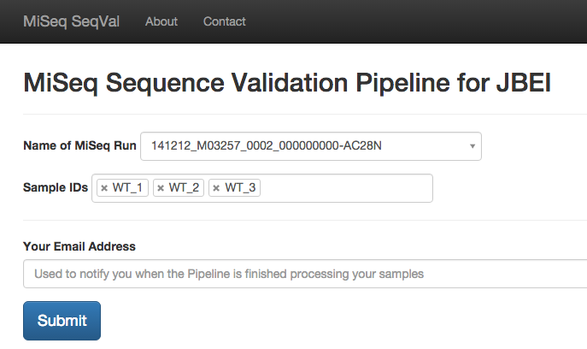
Website
Notes:
This website is up and running on my local
Name of MiSeq Run – Dropdown select2 menu, autofills with all the Folders currently on the SMB Server
Sample IDs – Dropdown select2 menu, autofills with applicable sample IDs _ Recently added button to auto fill this field with ALL samples for a given MiSeq run
Email – User’s email

Slide 8
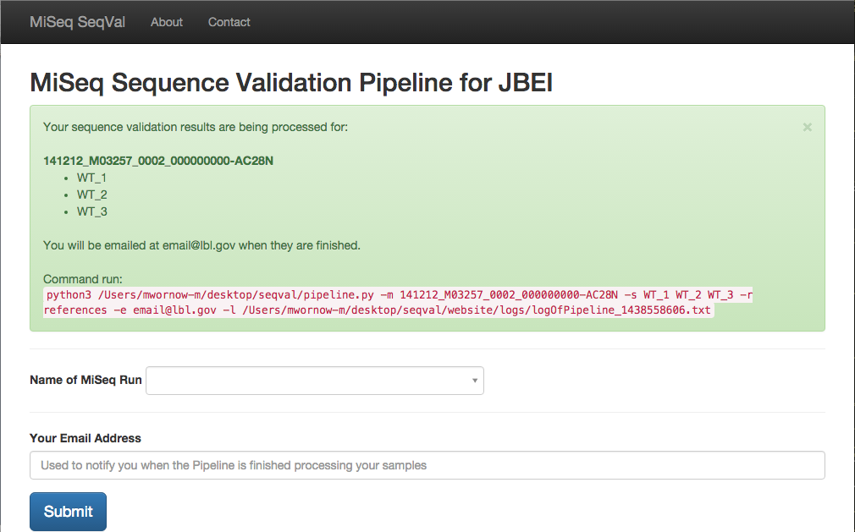
Notes:
After submitting the form, the website runs the command listed above in red. The pipeline.py itself is a command line utility with five flags:
-m MainLibraryName
-s SubLibrariesNames
-r ReferenceSequence
-e Email
-l LogFileLocation

Slide 9
Actual pipeline.py Output
mwornow-m:seqval mwornow-m$ python3 pipeline.py –m –s –r –e -l
Get sublibraries fastq.gz and reference sequences FASTA from SMB…
Running prep_ref…
Picard CreateSequencDictionary
Runtime.totalMemory()=128974848
BWA Index
Running beta_prep_setup_dirs…
AAHBB_libName_libName libName /Users/mwornow-m/Desktop/seqval/MiSeqOutputFolder/118433_TAAGGCG.fastq.gz
Running beta_slice_fq…
200.9517548084259 seconds
Running beta_run_alignments…
BWA
Picard FixMateInformation
Picard MarkDuplicates
Runtime.totalMemory()=128188416
2226.508181810379 seconds
Creating config.xml for postprocessing.sh script...
Running postprocessing.sh…
Running GATK Depth of Coverage...
covdepth file generated
Running GATK Unified Genotyper...
snps.gatk.vcf file generated
Running GATK Callable Loci...
callable.bed file generated
Running make_calls_gatk.py script...
call_summary.txt file generated
3-5 mins
30-40 mins with large JGI sequences, 5 mins with JBEI sequences
Notes:
This is output of the actual pipeline.py running.
The main bottleneck is the beta_run_alignments.pl _ With JGI’s longer fastq.gz, it took 30 mins for a SubLibrary. With JBEI’s fastq.gz’s, however, it only took about 5 minutes with 5 SubLibraries

Slide 10
What’s working
User submits info to website
Pipeline runs
Logs output
Runs MiSeq BAM Generation Tools and Post-Processing Scripts
Generates file structure storing all files (bam, bed, vcf, call_summary.txt)
This file structure can be zipped and archived for later review of sequencing runs
IGV file correctly generated
Note: JBEI’s pipeline yields more accurate data than JGI’s older pipeline, because JBEI uses more updated BWA, Samtools, and Picard

Slide 11
To do…
Have reference sequences come directly from ICE
Upload IGV files to ICE reference entry
Create interface in ICE to view IGV files
Send email to user notifying that pipeline has finished
Notes:
Fix beta_run_alignments.pl and run_bwa.pl => Explained on next slide

Slide 12
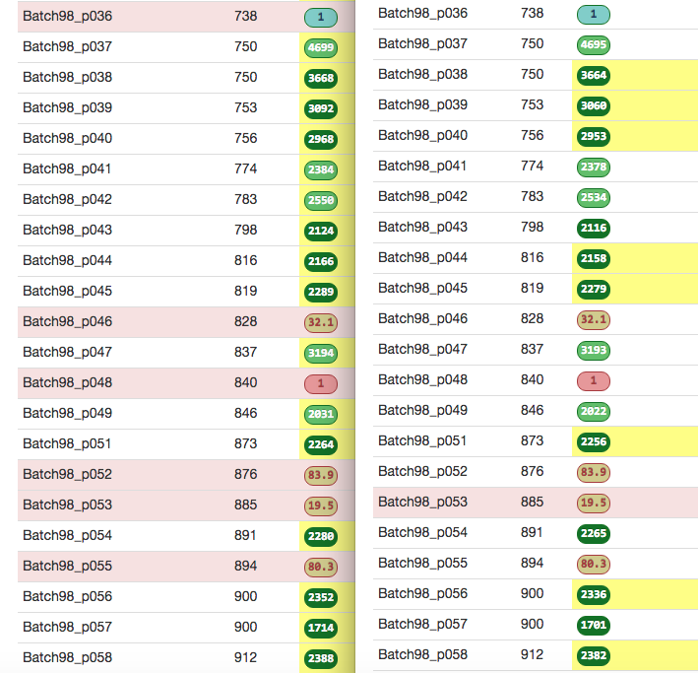
Old JGI Pipeline | Updated JBEI Pipeline
Notes:
UPDATE:
Discrepancy caused by version mismatch – my Pipeline.py uses more updated tools, yielding different results than JGI’s pipeline
---------------
For some reason, my Pipeline.py outputs very similar but slightly different numbers than Ernst’s JGI Pipeline.
The “type” of calls (e.g. color coding) is always correct, but the actual number in the circles can be off by 10-50 units.
I’ve traced the error to the beta_run_alignments.pl script of Joel’s Tools (which itself calls run_bwa.pl) but due to the extremely long running time of the script it’s been a bit hard to debug.
During the presentation, I asked Ernst what he thought about this discrepancy, and he said that he wasn’t sure why the numbers weren’t coming out right but that it might be OK.

